Slide 1
Crying Baby Detection
Rong Li
12/02/2019

Slide 2
Motivation
1. Realtime baby monitor: detect crying baby, activate recording and alarm, and send alerts to parents/teachers.
2. Daycare / school video recording footage: auto detect crying baby to cut and save the footage clips, send parents accident/activity reports.

Slide 3
Data Preparation - Scraping
Scraping crying / not crying baby images from internet

Slide 4
Data Preparation – Face Detection And Cut
Ultra light fast generic face detector 1MB (https://github.com/Linzaer/Ultra-Light-Fast-Generic-Face-Detector-1MB)

Slide 5
Training, Validation, Test Split
Training:
Crying Babies: 307 * 3 = 921
Not Crying Babies: 327 * 3 = 1116
Validation
Crying Babies: 103
Not Crying Babies: 124
Test
Crying Babies: 102
Not Crying Babies: 124

Slide 6
Training Data Preprocessing – Resize, Scale, Augment
train_datagen = ImageDataGenerator( rescale = 1.0/255., rotation_range = 40, width_shift_range = 0.2, height_shift_range = 0.2, zoom_range = 0.2, shear_range = 0.2, horizontal_flip = True)

Slide 7
Build Convolution Neural Network Model

Slide 8
Training And Validation

Slide 9
Model Evaluation – Confusion Matrix

Slide 10
Model Evaluation – Classification Report

Slide 11
Model Evaluation – Roc Curve
Auc Score is: 0.89

Slide 12
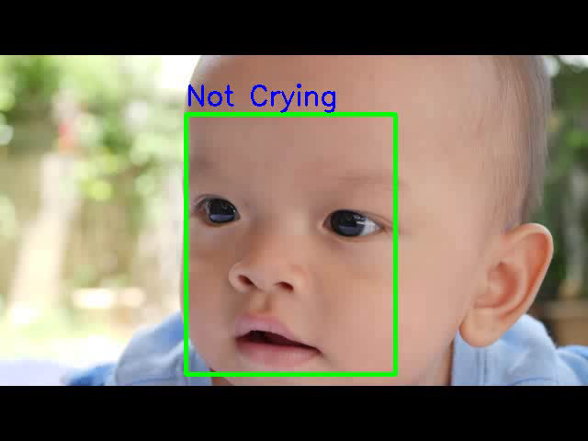
Original video from Videezy

Slide 13
Next Steps
Improve model accuracy
Input data: input figure size, data augmentation
Network: model, layers
Optimization: optimizer, learning rate, batch size, epoch
Add a crying sound classification, combine both facial expression and sound classification results to decide whether a crying baby is detected.

Slide 14
Thank You!

